Slide 1

EUREKA 2026 · STARTUP PITCH COMPETITION
NESTRO
India's 1st AI-Powered, 0% Brokerage Student Housing Platform
⚡ Real-Time Cloud Firestore Sync · 🛡️ Escrow Deposit Guarantee · 🤖 NEST AI Assistant
⚡ TEAM VELORA (Velocity + Aura)
Department: Integrated M.Tech in Artificial Intelligence & Machine Learning (AI-ML) — First Year · Sanjivani University
👑 Samruddhi Rajesh Gangad (Team Leader & UX Lead) | 💻 Pratik Thorat (Full-Stack & AI Lead) 📊 Kirti Honde (Market Analysis & Relations) | 🏢 Parth Pachpute (Operations & Host Lead)

Slide 2
🏆 EUREKA 2026 · SANJIVANI UNIVERSITY
The Problem: The Student & Parent Housing Crisis in College Hubs
CRITICAL FLAW 01
💸 ₹5,000+ Brokerage Extortion
Impact: 15–30 Days Rent Lost
Local offline brokers charge exorbitant 1-month brokerage just to give basic contact numbers. Middle-class student families lose ₹5,000+ before their semester even starts.
CRITICAL FLAW 02
📸 Fake Photos & Zero Hygiene
Impact: 90% Information Asymmetry
Misleading listings with photos taken 5 years ago. Broken bathrooms, undisclosed curfew lockdowns, and zero anti-ragging compliance on ground.
CRITICAL FLAW 03
🔒 Deposit Theft & Eviction Fears
Impact: ₹10,000 Security Lost
Landlords routinely refuse to refund security deposits upon move-out citing fake maintenance charges. Students have zero legal contracts or escrow protection.

Slide 3
🏆 EUREKA 2026 · SANJIVANI UNIVERSITY
The Solution: NESTRO — India's 1st 0% Brokerage AI Housing Platform
CORE PILLAR 01
🎓 100% Zero Brokerage
Value: Saves ₹5,000 Instantly
Students explore, compare, and visit stays completely free. No middleman cuts, no hidden viewing fees. 100% transparent pricing directly from hostel owners.
CORE PILLAR 02
🤖 NEST AI Campus Matchmaker
Value: < 2-Second Matching
Understands conversational queries in Hindi, Marathi & English. Matches students by budget, room sharing, food taste, and exact walking distance to Sanjivani University gates.
CORE PILLAR 03
🛡️ Escrow Deposit Guarantee
Value: 100% Money-Back Safety
Advance deposits remain locked in a bank-grade escrow account. Released to the owner ONLY after physical room check-in. Comes with a free Digital Tenancy Agreement PDF.

Slide 4

🏆 EUREKA 2026 · SANJIVANI UNIVERSITY
Product Live & Deployed: https://nestro.web.app/
⚡ PRODUCTION LIVE ARCHITECTURE
Built on Google Cloud & Firebase
🔥 Cloud Firestore: Real-time two-way synchronization for active hostel beds & waitlists.
🔒 Firebase Enterprise Auth: Secure phone/email student authentication with SSL encryption.
📱 Progressive Web App (PWA): Ultra-fast, installable mobile & desktop responsive experience.
⏳ Live Waitlist Engine: Real-time FIFO token queues for oversubscribed campus hostels.
📞 24/7 Student Helpline: Direct 1-click dialer & automated WhatsApp resolution (+91 98346 20537).
🧠 Supercharged Campus AI 3.0
• Natural Language Intent Parser for Marathi, Hindi, & English queries.
• Hyper-local Geolocation matching by distance to Sanjivani University gates.
• Empathetic Student Wellbeing Engine for homesickness & academic stress.
• 5-Step Owner KYC Portal with warden identity & room photo verification.

Slide 5
🏆 EUREKA 2026 · SANJIVANI UNIVERSITY
Monetization: 4 Scalable B2B & Micro-Transaction Revenue Streams
🏢 1. Property Owner Success Fee (B2B)
Unit Economics: ₹500 – ₹1,000 / Filled Bed
Hostel & PG owners pay a flat success commission per confirmed move-in. 4x cheaper than traditional offline brokers who charge ₹4,000+.
⭐ 2. Featured Spotlight Boosts (B2B)
Unit Economics: ₹1,500 – ₹3,000 / Month
Guaranteed Top-3 search visibility, gold 'Verified Partner' badge, and priority NEST AI recommendations during peak admission cycles.
🛡️ 3. Student Trust & Move-In Fee (Micro B2C)
Unit Economics: ₹99 Flat on Move-In
Nominal micro-fee for 100% Escrow deposit safety guarantee, dispute resolution, and instant downloadable legal Tenancy Agreement PDF.
📲 4. NESTRO HostelOS SaaS (B2B)
Unit Economics: ₹499 – ₹799 / Month
All-in-one software for hostel wardens: automated WhatsApp rent payment reminders, digital rent receipts, and biometric curfew logs.

Slide 6
🏆 EUREKA 2026 · SANJIVANI UNIVERSITY
Market Opportunity & Unfair Competitive Advantage
🎯 MARKET SIZE (TAM / SAM / SOM)
TAM: $14 Billion (₹1.15 Lakh Cr)
40 Million+ higher education students migrating across Indian university hubs.
SAM: 3.2 Million Students
Higher education student housing market across Maharashtra (Pune SPPU, Nashik, Shirdi, Mumbai).
SOM (Phase 1 Target):
150+ PGs and 5,000+ Student Beds in Sanjivani University & Kopargaon educational cluster.
⚔️ WHY NESTRO DOMINATES COMPETITION
• 0% Student Brokerage 👉 NESTRO: ✅ ₹0 | Brokers: ❌ ₹4,000+ fee
• Tier-2/3 College Town Focus 👉 NESTRO: ✅ 100% Hyper-local | MagicBricks/99acres: ❌ Metro only
• Walking Dist to Campus Gates 👉 NESTRO: ✅ Verified in meters | NoBroker: ❌ City-level only
• Escrow Deposit Security 👉 NESTRO: ✅ Bank-Grade Vault | Offline: ❌ Zero deposit safety
• Multilingual AI Matchmaker 👉 NESTRO: ✅ NEST AI 3.0 | Competitors: ❌ Keyword filters

Slide 7
🏆 EUREKA 2026 · SANJIVANI UNIVERSITY
Execution Roadmap: Scaling From Sanjivani to 50+ Campuses
Phase 1: Hyper-Local Pilot (Q1-Q2 2026)
📍 Sanjivani University & Kopargaon
• 100% Onboarding of 150+ local PGs and Hostels. • 500+ Confirmed student move-in bookings. • Establish Escrow Trust & Warden HostelOS adoption.
Phase 2: Regional Hubs (Q3-Q4 2026)
📍 Nashik, Shirdi & Ahmednagar Campuses
• Expand to 15+ Engineering, MBA & Medical colleges. • 2,500+ Active student bed listings on platform. • Deploy automated WhatsApp warden rent management.
Phase 3: State Rollout (2027)
📍 Pune SPPU & 50+ Maharashtra Hubs
• Scale to Pune University, PCMC, Aurangabad & Nagpur. • 20,000+ Students housed with zero brokerage. • Formal institutional MoUs with universities.

Slide 8
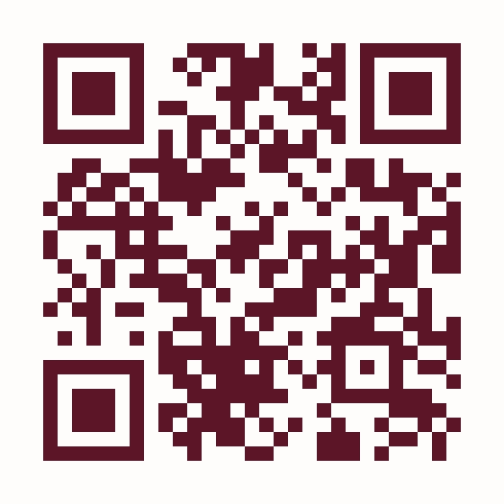
⚡ TEAM VELORA (Velocity + Aura)
Integrated M.Tech in AI-ML (First Year) · Sanjivani University
👤 Samruddhi Rajesh Gangad
👑 Team Leader & UX / Product Design Lead
👤 Pratik Thorat
💻 Full-Stack Developer & AI / Technical Lead
📲 SCAN WITH PHONE CAMERA
https://nestro.web.app/
Test live Firestore database, NEST AI & instant booking right now!
👤 Kirti Honde
📊 Market Analysis & Student Relations
👤 Parth Pachpute
🏢 Operations & Host Onboarding
🌐 LIVE APP: https://nestro.web.app/ | ✉️ nestrosupport@gmail.com | 📞 +91 98346 20537

